Slide 1
Accounting Information Systems
PRESENTED BY: EDGAR OTIENO
Lecture 6
SECURITY
Computer Controls and Auditing:
IT Controls Parts I and II

Slide 2
background
Local news: https://kenyandigest.com/cma-how-chase-bank-chiefs-siphoned-billions/

Slide 3
Objectives for Lecture 6
IT Controls Part I: Security and Access
  Threats to the operating system and internal controls (IC) to minimize them
  Threats to database integrity and IC to minimize them
  Risks associated with electronic commerce and IC to reduce them
IT Controls Part II: Systems Development, Program Changes, and Application Controls
  Controls and audit tests relevant to systems development
  Risks and controls for program changes and the source program library
  Auditing techniques (CAATTs) used to verify application controls
  Auditing techniques used to perform substantive tests in an IT environment

Slide 4
Goals of Security
Authorization
Authentication
Non repudiation
Integrity
Availability
Confidentiality

Slide 5
(1) IT Controls Part I: Security and Access
Notes:
10

Slide 6
Operating Systems
Perform three main tasks:
  translates high-level languages into the machine-level language
  allocates computer resources to user applications
  manages the tasks of job scheduling and multiprogramming
Notes:
10

Slide 7
Requirements for Effective Operating Systems Performance
Protect itself from tampering from users
Prevent users from tampering with the programs of other users
Safeguard users’ applications from accidental corruption
Safeguard its own programs from accidental corruption
Protect itself from power failures and other disasters
Notes:
11
11

Slide 8
Operating Systems Security
Log-On Procedure
  first line of defence – user IDs and passwords
Access Token
  contains key information about the user
Access Control List
  defines access privileges of users
Discretionary Access Control
  allows user to grant access to another user
Notes:
13

Slide 9
Operating Systems Controls
Access Privileges
Audit objectives: verify that access privileges are consistent with separation of incompatible functions and organization policies
Audit procedures: review or verify…
  policies for separating incompatible functions
  a sample of user privileges, especially access to data and programs
  security clearance checks of privileged employees
  formally acknowledgements to maintain confidentiality of data
  users’ log-on times
Notes:
18

Slide 10
Operating Systems S Controls
Password Control
Audit objectives: ensure adequacy and effectiveness password policies for controlling access to the operating system
Audit procedures: review or verify…
  passwords required for all users
  password instructions for new users
  passwords changed regularly
  password file for weak passwords
  encryption of password file
  password standards
  account lockout policies
Notes:
18

Slide 11
Operating Systems Controls
Malicious & Destructive Programs
Audit objectives: verify effectiveness of procedures to protect against programs such as viruses, worms, back doors, logic bombs, and Trojan horses
Audit procedures: review or verify…
  training of operations personnel concerning destructive programs
  testing of new software prior to being implemented
  currency of antiviral software and frequency of upgrades
Notes:
18

Slide 12
Operating System Controls
Audit Trail Controls
Audit objectives: whether used to (1) detect unauthorized access, (2) facilitate event reconstruction, and (3) promote accountability
Audit procedures: review or verify…
  how long audit trails have been in place
  archived log files for key indicators
  monitoring and reporting of security violations
Notes:
18

Slide 13
Database Management Controls
Two crucial database control issues:
Access controls
Audit objectives: (1) those authorized to use databases are limited to data needed to perform their duties and (2) unauthorized individuals are denied access to data
Backup controls
Audit objectives: backup controls can adequately recovery lost, destroyed, or corrupted data
Notes:
21
21

Slide 14
Access Controls
User views - based on sub-schemas
Database authorization table - allows greater authority to be specified
User-defined procedures - user to create a personal security program or routine
Data encryption - encoding algorithms
Biometric devices - fingerprints, retina prints, or signature characteristics
Notes:
22
22

Slide 15

Resource
Employee Line Cash Receipts
AR File File Printer Program
User
Read data
Change
Add
Delete
User 1
No Access Use No Access
Read code
No Access Use Modify
Delete
User 2
Read only
User 3
No Access Read only Use No Access
Notes:
15

Slide 16
Access Controls
Audit procedures: verify…
  responsibility for authority tables & subschemas
  granting appropriate access authority
  use or feasibility of biometric controls
  use of encryption
Notes:
21
21

Slide 17
Backup Controls
Database backup – automatic periodic copy of data
Transaction log – list of transactions which provides an audit trail
Checkpoint features – suspends data during system reconciliation
Recovery module – restarts the system after a failure
Notes:
24

Slide 18
Backup Controls
Audit procedures: verify…
  that production databases are copied at regular intervals
  backup copies of the database are stored off site to support disaster recovery
Notes:
21
21

Slide 19
Internet and Intranet Risks
Communications is a unique aspect of the computer networks:
  different than processing (applications) or data storage (databases)
Network topologies – configurations of:
  communications lines (twisted-pair wires, coaxial cable, microwaves, fiber optics)
  hardware components (modems, multiplexers, servers, front-end processors)
  software (protocols, network control systems)
Notes:
2

Slide 20
Sources of Internet & Intranet Risks
Internal and external subversive activities
  Audit objectives:
  prevent and detect illegal internal and Internet network access
  render useless any data captured by a perpetrator
  preserve the integrity and physical security of data connected to the network
Equipment failure
  Audit objective:
  the integrity of the electronic commerce transactions by determining that controls are in place to detect and correct message loss due to equipment failure
Notes:
2

Slide 21
Risks from Subversive Threats
Include:
  unauthorized interception of a message
  gaining unauthorized access to an organization’s network
  a denial-of-service attack from a remote location
Notes:
2

Slide 22
Internal Controls for Subversive Threats
Firewalls provide security by channeling all network connections through a control gateway.
  Network level firewalls
    Low cost and low security access control
    Do not explicitly authenticate outside users
    Filter junk or improperly routed messages
    Experienced hackers can easily penetrate the system
  Application level firewalls
    Customizable network security, but expensive
    Sophisticated functions such as logging or user authentication
Notes:
3

Slide 23
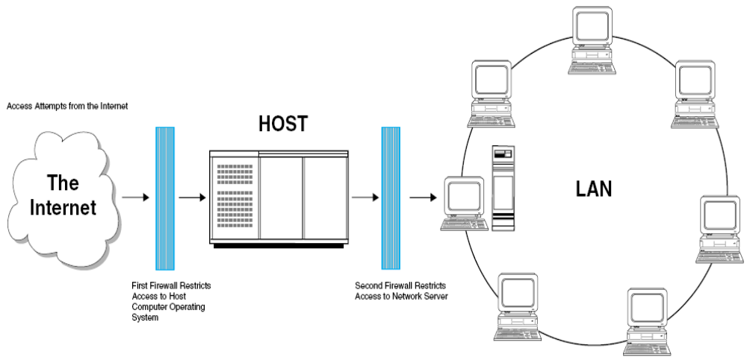
Dual-Homed Firewall

Slide 24
Internal Controls for Subversive Threats
Denial-of-service (DOS) attacks
  Security software searches for connections which have been half-open for a period of time.
Encryption
  Computer program transforms a clear message into a coded (cipher) text form using an algorithm.
Notes:
4

Slide 25


DOS Attack
Sender
Receiver
Step 1: SYN messages
Step 2: SYN/ACK
Step 3: ACK packet code
In a DOS Attack, the sender sends hundreds of messages, receives the
SYN/ACK packet, but does not response with an ACK packet. This leaves the
receiver with clogged transmission ports, and legitimate messages cannot be
received.
Notes:
6

Slide 26

Standard Data Encryption Technique
Key
Cleartext
Message
Encryption
Program
Communication
System
Ciphertext
Cleartext
Message
Encryption
Program
Communication
System
Ciphertext
Key
Notes:
7

Slide 27


Message A
Message B
Message C
Message D
Multiple people
may have the public key
Public Key used for
encoding messages
Ciphertext
Ciphertext
Ciphertext
Ciphertext
Typically one person or
a small number of people
have the private key
Private Key used for
decoding messages
Message A
Message B
Message C
Message D
Notes:
8

Slide 28
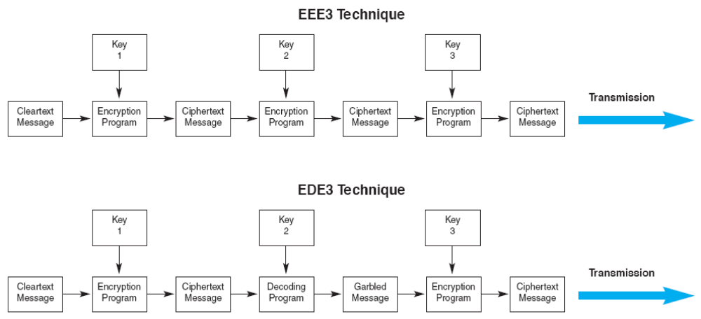
Advanced Data Encryption Technique

Slide 29
Internal Controls for Subversive Threats
Digital signature – electronic authentication technique to ensure that…
  transmitted message originated with the authorized sender
  message was not tampered with after the signature was applied
Digital certificate – like an electronic identification card used with a public key encryption system
  Verifies the authenticity of the message sender

Slide 30
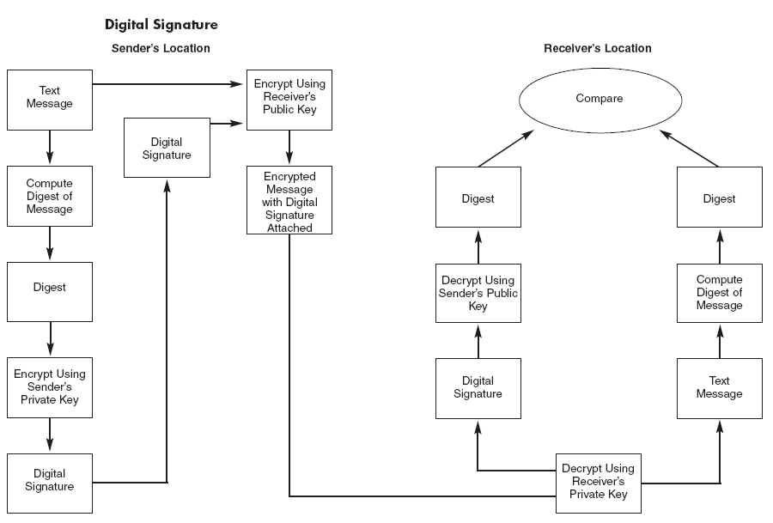
Digital Signature

Slide 31
Auditing Procedures for Subversive Threats
Review firewall effectiveness in terms of flexibility, proxy services, filtering, segregation of systems, audit tools, and probing for weaknesses.
Review data encryption security procedures
Verify encryption by testing
Review message transaction logs
Test procedures for preventing unauthorized calls

Slide 32
IC for Equipment Failure
Line errors are data errors from communications noise.
Two techniques to detect and correct such data errors are:
  echo check - the receiver returns the message to the sender
  parity checks - an extra bit is added onto each byte of data similar to check digits
Notes:
11

Slide 33
Electronic Data Interchange
Electronic data interchange (EDI) uses computer-to-computer communications technologies to automate B2B purchases.
Audit objectives:
  Transactions are authorized, validated, and in compliance with the trading partner agreement.
  No unauthorized organizations can gain access to database
  Authorized trading partners have access only to approved data.
  Adequate controls are in place to ensure a complete audit trail.
Notes:
9

Slide 34
EDI System without Controls
Company A
Company B (Vendor)
Application
Software
Purchases
System
Sales Order
System
Application
Software
EDI
Translation
Software
EDI
Translation
Software
Direct Connection
Communications
Software
Communications
Software
Notes:
14

Slide 35
EDI System with Controls
Company A
Company B (Vendor)
Application
Software
Purchases
System
Audit trail of
transactions between
trading partners
Sales Order
System
Application
Software
EDI
Translation
Software
EDI
Translation
Software
Transaction
Log
Transaction
Log
Communications
Software
Communications
Software
Other
Mailbox
Software limits vendor’s (Company B) access to company A’s database
Use of VAN to enforce use of passwords and valid partners
Company
A’s mailbox
VAN
Company
B’s mailbox
Other
Mailbox
Notes:
15

Slide 36
(2) IT Controls Part II: Systems Development, Program Changes, and Application Controls
Notes:
NOTE: This is used also as Figure 14-1.

Slide 37
Systems Development Activities
Authorizing development of new systems
Addressing and documenting user needs
Technical design phases
Participation of internal auditors
Testing program modules before implementing
  Testing individual modules by a team of users, internal audit staff, and systems professionals
Notes:
NOTE: This is used also as Figure 14-1.

Slide 38
Systems Development Life Cycle
Business Needs and
Strategy
Legacy Situation
Business Requirements
1. Systems Strategy
- Assessment
- Develop Strategic Plan
Feedback:
User requests for New Systems
System Interfaces, Architecture and User Requirements
High Priority Proposals undergo Additional Study and Development
2. Project Initiation
- Feasibility Study
- Analysis
- Conceptual Design
- Cost/Benefit Analysis
Feedback:
User requests for System Improvements and Support
Selected System Proposals go forward for Detailed Design
3. In-house Development
- Construct
- Deliver
4. Commercial Packages
- Configure
- Test
- Roll-out
New and Revised Systems Enter into Production
5. Maintenance & Support
- User help desk
- Configuration Management
- Risk Management & Security
Notes:
NOTE: This is used also as Figure 14-1.

Slide 39
Systems Development
Auditing objectives: ensure that...
  SDLC activities are applied consistently and in accordance with management’s policies
  the system as originally implemented was free from material errors and fraud
  the system was judged to be necessary and justified at various checkpoints throughout the SDLC
  system documentation is sufficiently accurate and complete to facilitate audit and maintenance activities
Notes:
14

Slide 40
Systems Development IC
New systems must be authorized.
Feasibility studies were conducted.
User needs were analyzed and addressed.
Cost-benefit analysis was done.
Proper documentation was completed.
All program modules must be thoroughly tested before they are implemented.
Checklist of problems was kept.
Notes:
30
30

Slide 41
System Maintenance IC
Last, longest and most costly phase of SDLC
  Up to 80-90% of entire cost of a system
All maintenance actions should require
  Technical specifications
  Testing
  Documentation updates
  Formal authorizations for any changes
Notes:
31
31

Slide 42
Program Change
Auditing objectives: detect unauthorized program maintenance and determine that...
  maintenance procedures protect applications from unauthorized changes
  applications are free from material errors
  program libraries are protected from unauthorized access
Notes:
16

Slide 43
Program Change
Auditing procedures: verify that programs were properly maintained, including changes
Specifically, verify…
  identification and correction of unauthorized program changes
  identification and correction of application errors
  control of access to systems libraries
Notes:
16

Slide 44
Application Controls
Narrowly focused exposures within a specific system, for example:
  accounts payable
  cash disbursements
  fixed asset accounting
  payroll
  sales order processing
  cash receipts
  general ledger
Notes:
9
9

Slide 45
Application Controls
Risks within specific applications
Can affect manual procedures (e.g., entering data) or embedded (automated) procedures
Convenient to look at in terms of:
  input stage
  processing stage
  output stage
INPUT
PROCESSING
OUTPUT
Notes:
21
21

Slide 46
Application Input Controls
Goal of input controls - valid, accurate, and complete input data
Two common causes of input errors:
  transcription errors – wrong character or value
  transposition errors – ‘right’ character or value, but in wrong place
Notes:
21
21

Slide 47
Application Input Controls
Check digits – data code is added to produce a control digit
  especially useful for transcription and transposition errors
Missing data checks – control for blanks or incorrect justifications
Numeric-alphabetic checks – verify that characters are in correct form
Notes:
22
22

Slide 48
Application Input Controls
Limit checks – identify values beyond pre-set limits
Range checks – identify values outside upper and lower bounds
Reasonableness checks – compare one field to another to see if relationship is appropriate
Validity checks – compares values to known or standard values
Notes:
23
23

Slide 49
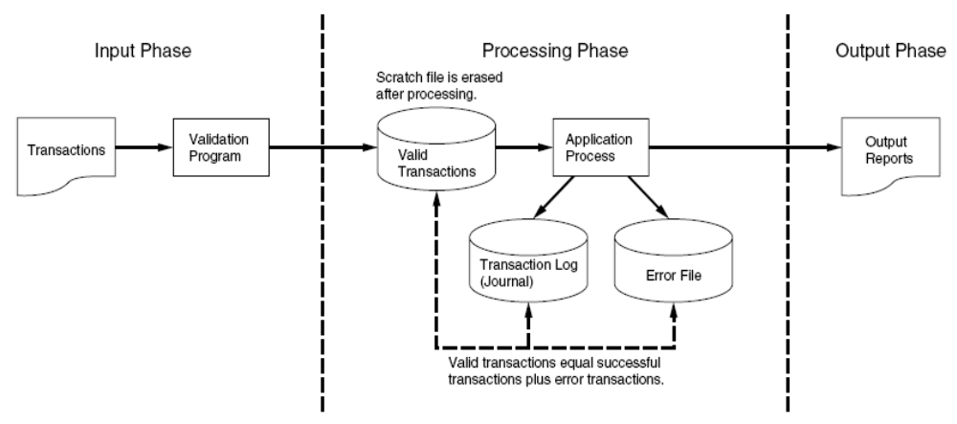
Transaction Log to Preserve the Audit Trail
Notes:
32

Slide 50
Application Output Controls
Goal of output controls is to ensure that system output is not lost, misdirected, or corrupted, and that privacy is not violated.
In the following flowchart, there are exposures at every stage.
Notes:
33

Slide 51
Application Controls Output
Waste – can be stolen if not properly disposed of, e.g., shredding
Report distribution – for sensitive reports, the following are available:
  use of secure mailboxes
  require the user to sign for reports in person
  deliver the reports to the user
Notes:
33

Slide 52
Application Controls Output
End user controls – end users need to inspect sensitive reports for accuracy
  shred after used
Controlling digital output – digital output message can be intercepted, disrupted, destroyed, or corrupted as it passes along communications links
Notes:
35

Slide 53
Testing Application Controls
Techniques for auditing applications fall into two classes:
  1) testing application controls – two general approaches:
    black box – around the computer
    white box – through the computer
  2) examining transaction details and account balances—substantive testing
Notes:
3

Slide 54
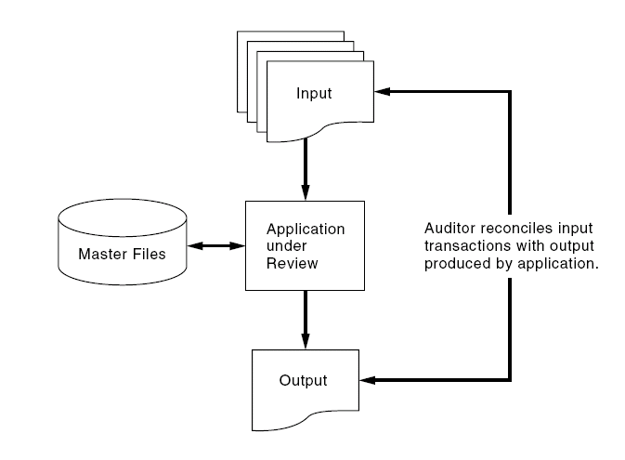
Auditing Around the Computer -
The Black Box Approach

Slide 55
Testing Application Controls
Black Box Approach – focuses on input procedures and output results
To Gain need understanding…
  analyze flowcharts
  review documentation
  conduct interviews
Notes:
25

Slide 56
Testing Application Controls
White Box Approach - focuses on understanding the internal logic of processes between input and output
Common tests
  Authenticity tests
  Accuracy tests
  Completeness tests
  Redundancy tests
  Access tests
  Audit trail tests
  Rounding error tests
Notes:
25

Slide 57
White Box Testing Techniques
Test data method: testing for logic or control problems - good for new systems or systems which have undergone recent maintenance
  base case system evaluation (BCSE) - using a comprehensive set of test transactions
  tracing - performs an electronic walkthrough of the application’s internal logic
Test data methods are not fool-proof
  a snapshot - one point in time examination
  high-cost of developing adequate test data
Notes:
27

Slide 58
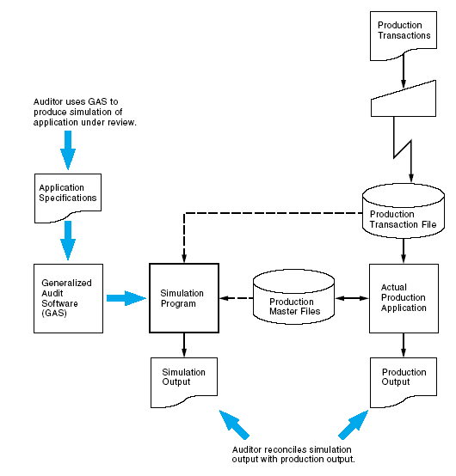
Auditing through the Computer:
The Parallel Simulation Technique

Slide 59
Embedded Audit Module
An ongoing module which filters out non-material transactions
The chosen, material transactions are used for sampling in substantive tests
Requires additional computing resources by the client
Hard to maintain in systems with high maintenance
Notes:
34

Slide 60
Generalized Audit Software
Very popular & widely used
Can access data files & perform operations on them:
  screen data
  statistical sampling methods
  foot & balance
  format reports
  compare files and fields
  recalculate data fields
Notes:
36

